Slide 1
Upper and Lower Extremity Prosthetics
By:
Abdullah Radwan

Slide 2
What is the difference between a prosthesis and an orthosis?
A prosthesis is a device or an artificial substitute designed to replace, as much as possible, the function or appearance of a missing limb or body part. An orthosis is a device designed to supplement or augment the function of an existing limb or body part.
A prosthesis is often also referred to as a prosthetic device. Similarly, an orthosis is often referred to as an orthotic device.

Slide 3
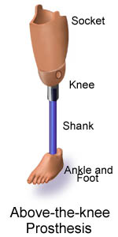
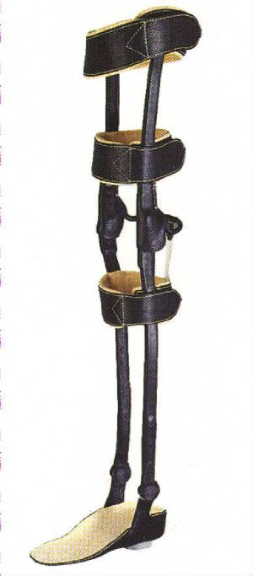
a prosthesis and an orthosis

Slide 4
What should be considered when choosing a prosthesis?
What is the amputation level?
What is the expected function of the prosthesis?
What is the cognitive function of the patient?
What is the patient's vocation (desk job vs manual laborer)?
What are the patient's avocational interests (ie, hobbies)?
What is the cosmetic importance of the prosthesis?
What are the patient's financial resources (eg, medical insurance, worker's compensation)?

Slide 5
Successful rehabilitation allows the individual with an amputation to return to their highest level of activity and function.

Slide 6
INCIDENCE AND ETIOLOGY
A) Acquired Amputation:
Acquired amputation accounts for 96% to 99% of all limb loss with the remaining 1% to 4% related to congenital causes.
Causes of amputation in the lower extremity (LE):
Vascular disease (75% to 93%) (Diabetic vascular disease, atherosclerosis, immunologic, and idiopathic).
Traumatic injuries to the extremities (6% to 10%)
Benign or malignant tumors.
Causes of amputation in the upper extremity (UE):
Trauma (80%). The vast majority of traumatic UE amputations are limited to the digital amputations.
Tumor is the most common cause of UE amputation in children.

Slide 7
B) Congenital Amputation:
  The absence of part or all of an extremity at birth is referred to as a congenital skeletal deficiency rather than a congenital amputation.
  The etiology is unknown but a few genetically determined syndromes, such as Holt-Oram, Fanconi, thrombocytopenia, absent radius and drugs (e.g., thalidomide) have been associated with skeletal deficiencies.
  The International Society for Prosthetics and Orthotics classifies congenital limb loss as either a transverse or longitudinal skeletal deficiency.
  Transverse limb deficiency, or terminal deficiency, is defined as the loss of all skeletal components distal to a particular transverse axis level (e.g., transverse forearm or transverse radial limb deficiency).
  Longitudinal limb deficiency, or intercalary limb loss, is defined as the loss (complete or partial) of one or more skeletal elements within the long axis of the limb.

Slide 8
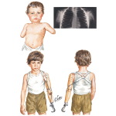
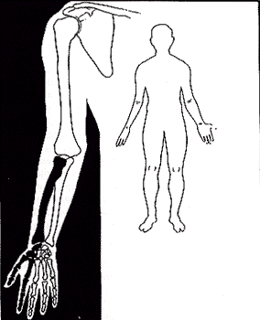
Transverse versus longitudinal limb deficiency

Slide 9
Amputation Surgery:
The basic principle in choosing the level of amputation is to preserve as much limb length as possible that is consistent with:
Wound healing,
An acceptable soft-tissue envelope, and
Functional prosthetic fitting.
Amputation surgery must be approached as a reconstructive procedure:
Bones are beveled to minimize sharp edges that can cause tissue trauma and pain with weight bearing.
Nerves are sharply transected and allowed to retract into proximal soft tissues to avoid its adherence in scar or its remain in a location subjected to high loading forces from a prosthesis.
Myofascial closure of the muscle or myodesis should be appropriate to provide good control of the remaining bone in the residual limb, and
Skin incision line should be appropriate to avoid bony prominences and adherence to underlying bone.

Slide 10
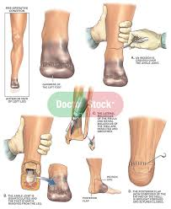
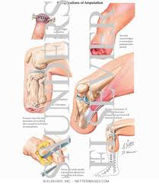
Amputation Surgery:

Slide 11
Levels of amputation:
LOWER EXTREMITY
Toe amputations
Ray resections
Transmetatarsal amputations
Syme amputation (i.e., ankle disarticulation)
Transtibial amputation (between the junction of the middle and distal thirds of the leg)
Knee disarticulation
Transfemoral amputation (8 cm or more proximal to the level of the knee joint)
Hip disarticulation (short transfemoral amputation at or proximal to the greater trochanter is functionally a hip disarticulation)
Hemipelvectomy

Slide 12
Levels of amputation:
UPPER EXTREMITY
Finger or thumb amputation
Ray resection
Transmetacarpal resection
Wrist disarticulation
Transradial amputation
Elbow disarticulation
Transhumeral amputation (i.e., 6.5 cm or more proximal to the elbow joint)
Shoulder disarticulation
Forequarter amputation (interscapulothoracic disarticulation)

Slide 13
LOWER EXTREMITY AMPUTATION
The process of prosthetic rehabilitation can be organized into a four-phase process:
Preprosthetic management,
Postoperative care,
Prosthetic fitting and training,
Long-term follow-up care.

Slide 14
I. PREPROSTHETIC PATIENT EVALUATION AND MANAGEMENT
  It is performed pre- or postoperatively.
  It should focus on identifying factors that will affect the functional status of the patient and limit prosthetic fitting.
  Issues that need evaluation include:
    Assessment of the premorbid functional status,
    Identification of coexisting musculoskeletal, neurologic, and cardiopulmonary disease that will influence rehabilitation potential,
    Determination of the available social support network,
    Understanding the patient's goals and expectations postamputation.
  Therapy program consists of:
    range of motion and conditioning exercises,
    correct positioning of the residual limb,
    ambulation with gait aids,
    relaxation techniques, and
    performance of activities of daily living (ADLs) should be started as soon as medically appropriate.

Slide 15
II. POSTOPERATIVE CARE
Goals of Post Operative Management of the Amputee
Successful healing of the amputation
Pain control
Maintaining range of motion in the remaining proximal joints of the amputated extremity
Strengthening of residual muscle groups needed for biomechanical compensation
Preparation of the residual limb for prosthetic fitting
Achieving independence in ADL's and mobility without a prosthetic limb
Education about the process of prosthetic limb fitting and expected functional outcome.
Psychosocial support for the adaptations resulting from the amputation.

Slide 16
During the immediate postoperative period, good medical control of the underlying disorders that can interfere with rehabilitation is achieved (e.g., diabetes, coronary artery disease, congestive heart failure, renal disease).
Maintaining nutritional status that plays a critical role in proper wound healing and in facilitating the muscular strength adaptations needed for prosthetic mobility.

Slide 17
Options for wound management include:
(A) Soft dressings:
They are used with an elastic bandage wrap (i.e., Ace bandage) or a compressive stockinette.
Advantages include:
  readily available,
  quickly applied, and
  allowing frequent wound inspection.
Disadvantages include:
  they do not provide protection from external trauma and
  have a limited ability to control edema
  If poorly applied, elastic wraps can lead to tourniquet effect.
Alternatives such as compressive stockinettes, elastic stump shrinkers, or roll-on gel liners could be a better choice of edema management.

Slide 18
(B) Rigid dressings:
They reduce wound-healing time and lead to more rapid and improved rehabilitation.
Disadvantages include :
the inability to inspect the wound
the potential increase in wound breakdown from incorrect application or early weight bearing in dysvascular individuals with an amputation.
They may be the preferred method of wound care especially for the transtibial individual with an amputation.
Rigid dressings can be fabricated as:
a removable rigid dressing that resembles a transtibial prosthetic socket or
a nonremovable cast that extends to the midthigh level.
A nonremovable rigid dressing is typically applied during or shortly after surgery and replaced every 7 to 14 days.
The midthigh length of the dressing prevents knee flexion contractures.
Subsequent dressings are fabricated as removable rigid dressings that can be taken off whenever the wound needs to be inspected.

Slide 19
The preprosthetic phase of management, before preparatory prosthetic fitting, can typically last 6 to 10 weeks for the individual with a dysvascular LE amputation, a shorter period of time for the individual with a traumatic amputation, and 3 to 6 weeks for the individual with a UE.
Muscle imbalance and postoperative positioning to facilitate comfort leads to the development of knee flexion contracture in the transtibial residual limb and to hip flexion and abduction contractures in the individual with a transfemoral amputation.

Slide 20
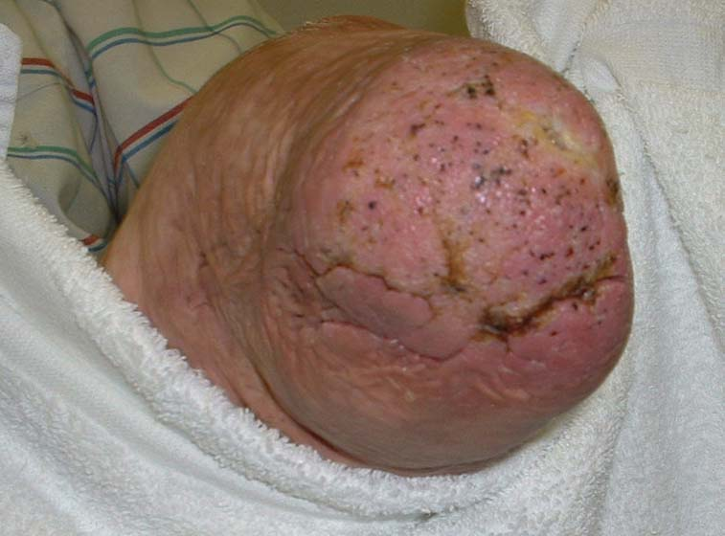
Transtibial amputation stump

Slide 21
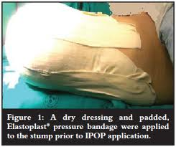
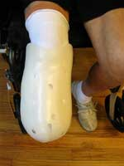
Soft versus rigid dressings

Slide 22
Contractures are preventable through a postoperative therapy program that emphasizes range of motion exercises and early remobilization.
Strengthening of muscle groups that biomechanically substitute for the lost function of the limb is needed. In LE amputation, the hip extensors (gluteus maximus and hamstrings), gluteus medius, hip flexors, and the contralateral ankle plantar flexors all contribute to restoring ambulation ability.
In UE amputation, proximal shoulder girdle muscle strengthening should be taught, emphasizing the trapezius, serratus anterior, pectoralis major, as well as any residual deltoid and biceps functions.

Slide 23
III. PROSTHETIC FITTING AND TRAINING
Negative prognostic factors that limit prosthetic fitting include:
a delay in wound healing,
the presence of joint contractures,
dementia or cognitive disorders,
medical comorbidities, and
higher levels of limb amputation (transfemoral)
advanced age (>80 to 85 years).

Slide 24
Requirements of proper fitting and training:
  reasonable cardiovascular reserve,
  adequate wound healing,
  adequate soft-tissue coverage,
  range of motion,
  muscle strength,
  motor control,
  learning ability to achieve useful prosthetic function.

Slide 25
Poor candidates for functional prosthetic fitting include:
dysvascular LE amputation with an open or poorly healed incision,
a transfemoral amputation with a 30-degree flexion contracture at the hip
a transradial amputation with a flail elbow and shoulder
a bilateral, short, transfemoral amputation over the age of 45
additional medical problems such as severe coronary artery disease, pulmonary disease, severe polyneuropathy, or multiple-joint arthritis.
significant fluctuations in body weight.

Slide 26
The timing of prosthetic application is controversial.
The prosthesis is typically applied in two stages:
(A) The preparatory prosthesis which is characterized by:
simple design,
lower performance,
more accommodating to changes in residual limb volume.
allows amputated patient to gain skill and confidence in walking with prosthesis,
facilitates residual limb maturation,
affords the rehabilitation team the opportunity to better define the ultimate functional level of the individual.

Slide 27
(B) The definitive prosthesis:
  It is prescribed after stump maturation to meet the ADLs and vocational and avocational needs of the individual with an amputation.
  Stump maturation occurs when:
the volume of the residual limb has stabilized,
soft-tissue atrophy has occurred,
the residual limb has been molded into a cylindrical shape that optimizes prosthetic fitting.
Residual limb maturation typically takes about 4 months but may extend longer depending on the activity level, amount of prosthetic limb use, and coexisting medical disease.
  Patients who are not candidates for functional prosthetic use may have a cosmetic prosthesis. These cosmetic prostheses can be fabricated to have an appearance similar to that of the opposite limb.

Slide 28
GAIT TRAINING
The individual with a new amputation will require a period of gait training to learn how to function with the prosthesis.
This training takes place under the supervision of the physical therapist.
The individual with amputation is instructed in:
how to put on and take off the prosthesis,
how to determine the appropriate number of limb socks to be worn,
when and how to check the skin for evidence of irritation, and
how to clean and care for the prosthesis.
The more proximal levels of amputation require lengthier gait training.
Gait training begins with: 1) weight shifting and balance activities while still in the parallel bars. then, 2) a program of progressive ambulation begins in the parallel bars, and 3) progresses to the most independent level of ambulation possible with or without gait aids.
Specific training should focus on transfers, gaining knee stability, equal step lengths, and avoiding lateral trunk bending.
Following ambulation on flat and level surfaces, techniques for managing uneven terrain, stairs, ramps, curbs, and falling and getting up off the ground are learned.
For higher functioning individuals with an amputation, prosthetic training should include instruction and practice in driving, recreation, and vocational pursuits.

Slide 29
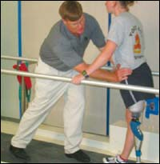
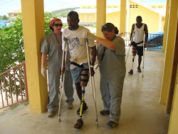
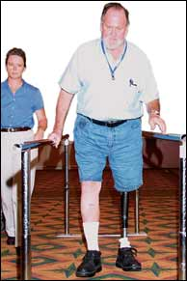
Gait training for amputee

Slide 30
IV. LOWER EXTREMITY PROSTHETIC FOLLOW-UP
During the initial 6 to 18 months, most individuals with an amputation will experience continued loss of residual limb volume, resulting in a prosthetic socket that will be too large. During this period, return visits should occur frequently to ensure that this loss of residual limb volume is compensated by the use of additional limb socks or by appropriate modifications of the prosthetic socket.
During follow-up clinic visits the condition of the residual limb, the prosthesis, the individual's gait, and the level of function are reviewed.
When the residual limb volume has stabilized sufficiently and the patient is doing well with the prosthesis, yearly visits to the amputee clinic are appropriate.
Once the residual limb has stabilized, the average life expectancy for LE prosthesis before replacement should be 3 to 5 years.

Slide 31
Determination of functional level for medicare patients
Centers for Medicare Services (CMS), requires a determination of functional level with certificates of medical necessity for prostheses:
K0: Does not have the ability to ambulate or transfer safely with or without assistance and a prosthesis does not enhance his/her quality of life or mobility.
K1: Has the ability to use a prosthesis for transfers or ambulating on level surfaces at fixed cadence. Typical of the limited and unlimited household ambulator.
K2: Has the ability for ambulation with the ability to traverse environmental barriers such as curbs, stairs, or uneven surfaces. Typical of the limited community ambulator.
K3: Has the ability for ambulation with variable cadence. Typical of the community ambulator who has the ability to traverse most environmental barriers and may have vocational, therapeutic, or exercise activity that demands prosthetic utilization beyond simple locomotion.
K4: Has the ability for prosthetic ambulation that exceeds basic ambulating skills, exhibiting high impact, stress, or energy levels. Typical of the prosthetic demands of the child, active adult, or athlete.

Slide 32
Thank you

